Slide 1

Bayesian Optimization & Genetic Algorithms
An architectural and conceptual overview of the two state-of-the-art model-based tuning techniques.

Slide 2
Bayesian Optimization & Genetic Algorithms
An architectural and conceptual overview of the two state-of-the-art model-based tuning techniques.

Slide 3

Model 3: Bayesian Optimization
Sequential Model-Based Optimization (SMBO) using probabilistic models.

Slide 4

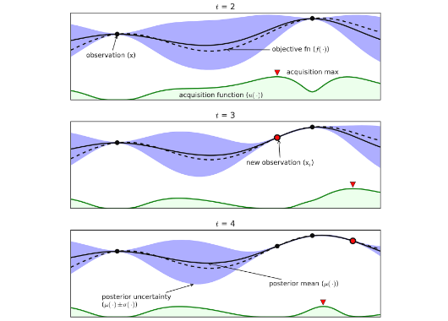
Model 3Bayesian Optimization Core Concept
Bayesian Optimization operates by treating the validation accuracy as a black-box function and approximating it via a **Surrogate Model**:
→
Surrogate Model: Typically a Gaussian Process (GP), it models the predicted performance and the statistical uncertainty at untested regions.
→
Feedback Loop: Every new objective evaluation updates the model's posterior distribution, refining predictions dynamically.

Slide 5


MechanicsThe Math & Acquisition Functions
Balancing Exploration vs. Exploitation
Bayesian Optimization uses an Acquisition Function to select the next hyperparameter set to evaluate:
•
Expected Improvement (EI): Measures likelihood of discovering a point superior to the current best.
•
Exploitation: Tests regions predicted to yield high accuracy.
•
Exploration: Directs testing toward areas with maximum uncertainty to build a more accurate surrogate model.

Slide 6






EvaluationBayesian Optimization: Pros & Cons
Key Advantages
Key Bottlenecks
Best Used For
Highly sample-efficient. Finds near-optimal parameters in a fraction of evaluations compared to Grid or Random search. Excellent for heavy deep learning models.
Computational overhead scales cubically with the number of iterations because of Gaussian Process updates. Difficult to parallelize since it is inherently sequential.
Extremely expensive evaluation tasks where a single run of the machine learning model takes hours or days to compute.

Slide 7
Model 4: Genetic Algorithms
Evolutionary heuristics modeled after biology and natural selection.

Slide 8
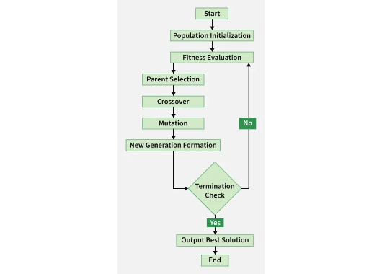
Model 4Genetic Algorithms (GA) Core Concept
Genetic Algorithms find optimal hyperparameters by treating parameters like genetic material and evolving them over generations:
→
Chromosomes: Every hyperparameter configuration behaves as a chromosome string (encoded values).
→
Fitness Value: The performance/validation accuracy score of the ML model acts as its survival fitness.
→
Generation Evolution: Weak parameters are discarded while high-performing strings reproduce.

Slide 9
MechanicsThe Genetic Algorithm Workflow Loop
2. Selection
4. Mutation
Evaluate the model's fitness and pick parent configurations with the highest accuracy.
Randomly alter small values to explore new configurations and evade local optima.
1. Initialization
3. Crossover
Generate an initial random population of hyperparameter configuration candidates.
Merge parents' chromosomes to produce offspring with shared parameters.

Slide 10
EvaluationGenetic Algorithms: Pros & Cons
Key Advantages
Key Bottlenecks
Best Used For
Superb global search performance. Extremely robust against getting stuck in local minima. Exceptionally easy to parallelize since populations run simultaneously.
Requires large populations to be effective, which may lead to high initial computing overhead. Complex setup parameters (mutation rates, crossover methods).
Large multidimensional hyperparameter spaces, non-continuous parameter structures, and environments with distributed training cluster capability.

Slide 11
Questions & Answers
Thank you for listening! Let's discuss advanced optimization.
Parameter Tuning Presentation
machine.learning@university.edu

